Slide 1


Medical Inventory Optimization Model

Slide 2
Contents
Business Objective
Business Constraints
Project Architecture - Data Flow Diagram
Data Collection
Exploratory Data Analysis
Data Visualization
Notes:
Change

Slide 3
Business Problem
Business Problem: Bounce rate is increasing significantly leading to patient dissatisfaction.
Business Objective: Minimize bounce rate.
Business Constraint: Minimize inventory cost.
Success Criteria: Business Success Criteria: Reduce bounce rate by at least 30%.
Economic Success Criteria: Increase revenue by at least 20 lacs INR by reducing bounce rate.

Slide 4

Project Overview and Scope
The project aims to address the increasing bounce rate in the hospital's pharmacy, which has been causing patient dissatisfaction. The scope of this project is to develop and implement a medical inventory optimization model specifically for the pharmacy department of the leading hospital in India. The model will focus on improving inventory management practices to reduce bounce rates and minimize inventory costs.

Slide 5
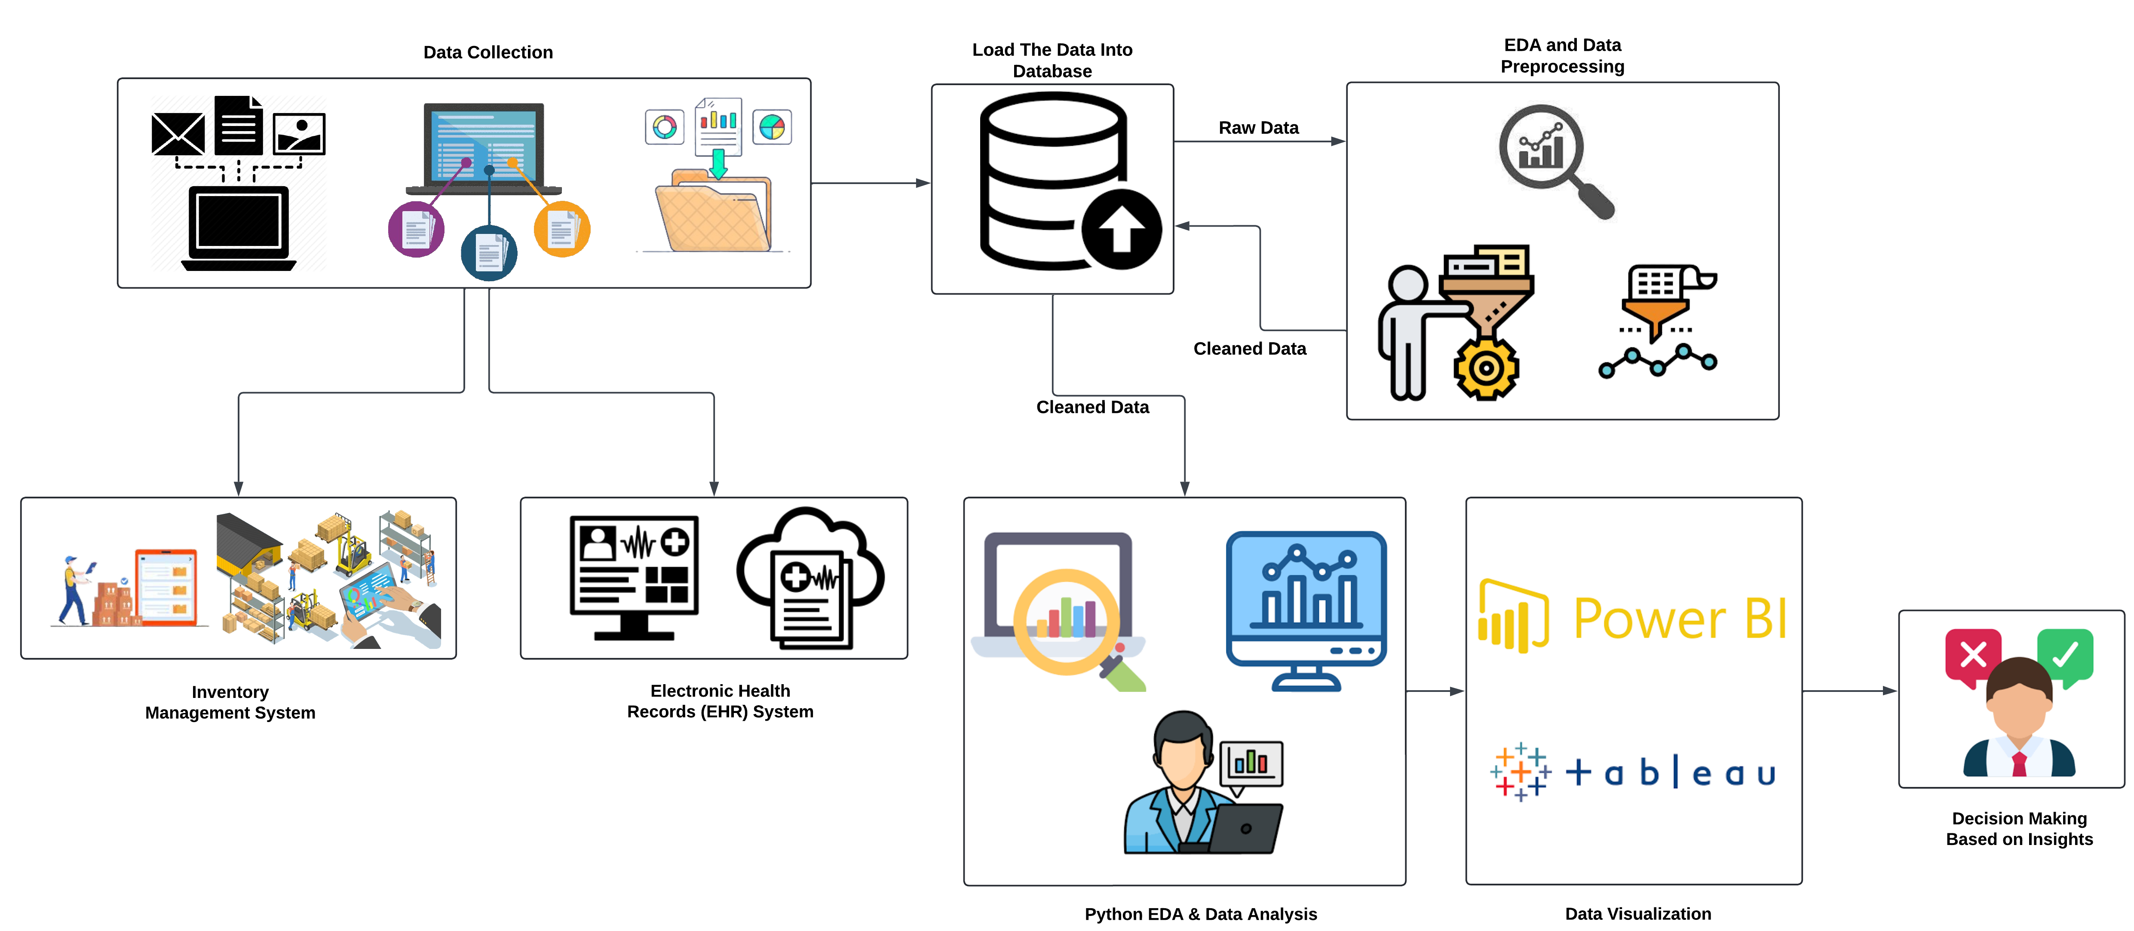
Project Architecture

Slide 6
Data Dictionary
VARIABLE NAME | VARIABLE DESCRIPTION
Typeofsales | Type of sale of the drug. Either the drug is sold or returned.
Patient_ID | ID of a patient
Specialisation | Name of Specialisation (eg. Cardiology)
Dept | Pharmacy, the formulation is related with.
Dateofbill | Date of purchase of medicine
Quantity | Quantity of the drug
ReturnQuantity | Quantity of drug returned by patient to the pharmacy
Final_Cost | Final Cost of the drug (Quantity included)
Final_Sales | Final sales of drug
RtnMRP | MRP of returned drug (Quantity included)
Formulation | Type of formulation
DrugName | Generic name of the drug
SubCat | Subcategory (Type) to the category of drugs.
SubCat1 | Subcategory (condition) to the category of drugs

Slide 7
Exploratory Data Analysis [EDA]
Statistical Insights
Business Insights
Sales figures exhibit a positively skewed distribution, with a skewness value of 21.0045.
The median quantity of medication purchased per transaction is 1 unit.
Standard deviation of $182.259, indicating variability in the retail prices of returned items.
The mean final cost of medication is $124.8239, with standard deviation of $464.7664.
The minimum final cost of medication per transaction is $40, while the maximum cost reaches $33,178.
On average, customers purchase around 2 units of medication per transaction.
Returns are infrequent, with most transactions not involving any returned items.
The average cost of medication per transaction is $124.82, but costs vary significantly.
Sales figures are positively skewed, indicating a few high-value transactions.
Most returned items have a retail price close to zero.
Notes:
EDA is used for seeing what the data can tell us before the modeling task.
Change

Slide 8


Data Preprocessing
Missing values were addressed using appropriate techniques like Replacing outliers in numerical columns with the median value
Duplicates were identified and removed to ensure data integrity and derive actionable insights for business clients
Notes:
Keep observations

Slide 9
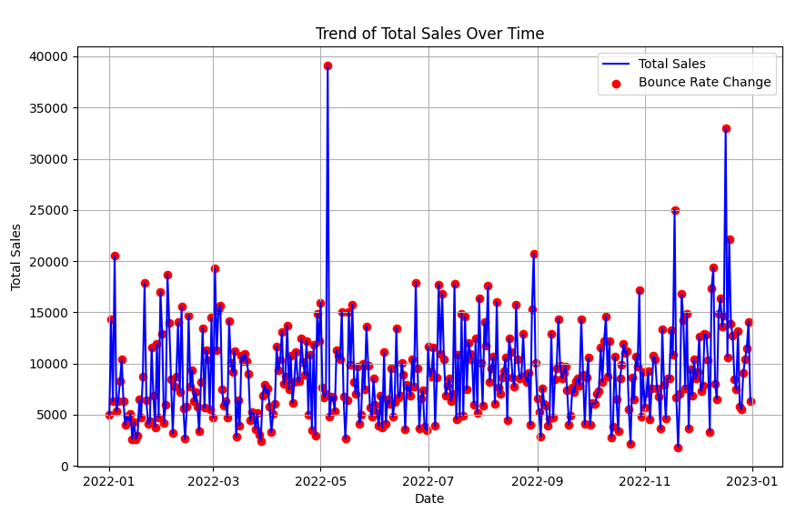
Data Visualization
Notes:
Add graphical

Slide 10
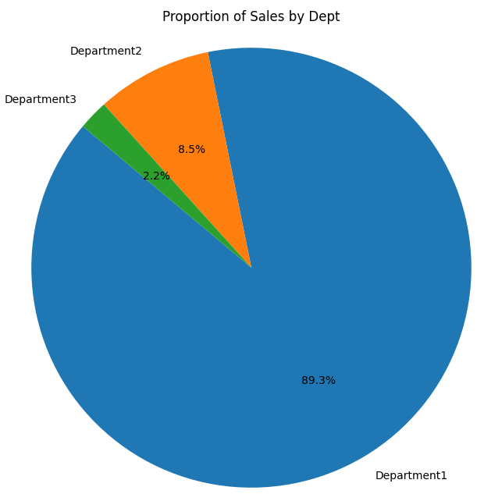
Data Visualization
Notes:
Add graphical

Slide 11
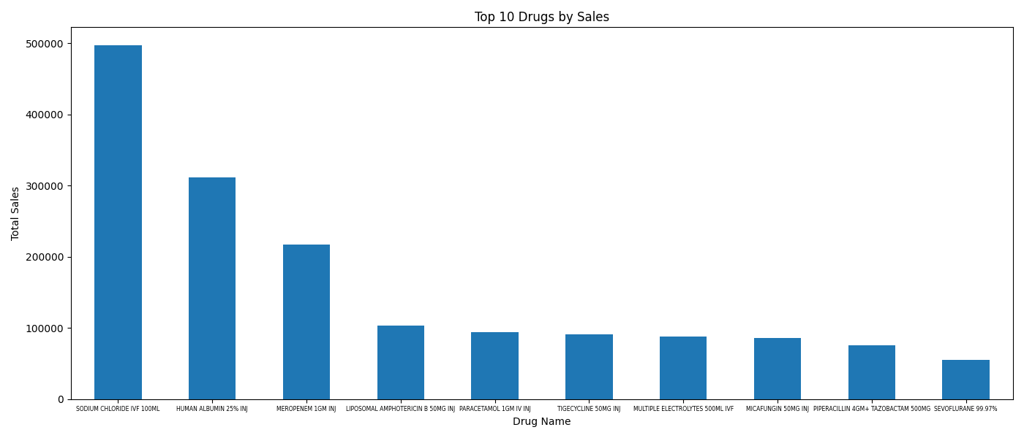
Data Visualization
Notes:
Add graphical

Slide 12
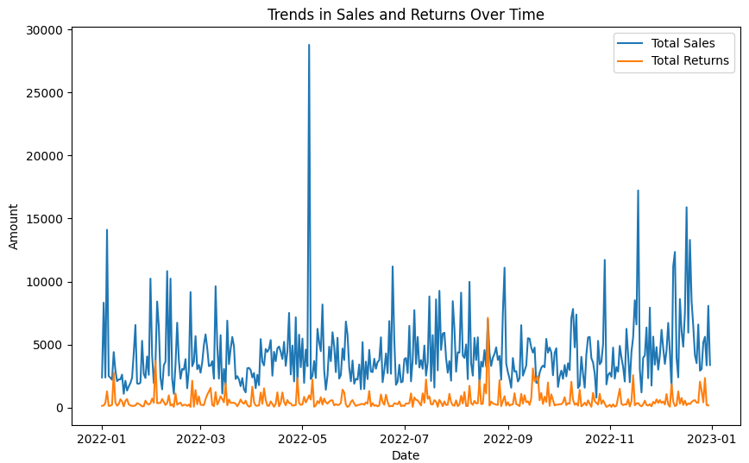
Data Visualization
Notes:
Add graphical

Slide 13


